Slide 1
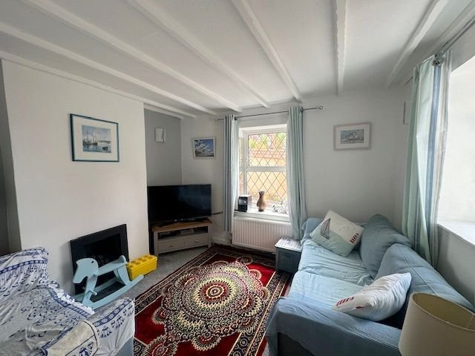
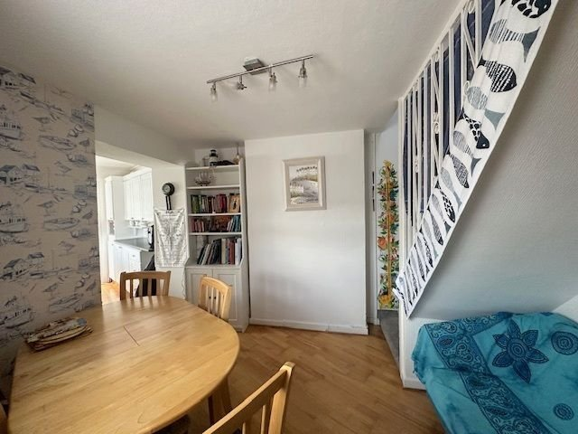
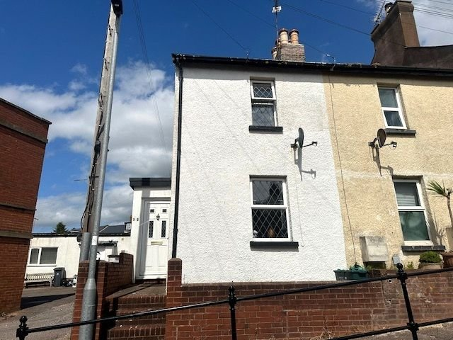
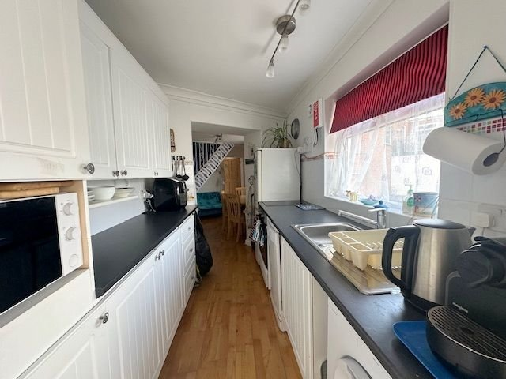
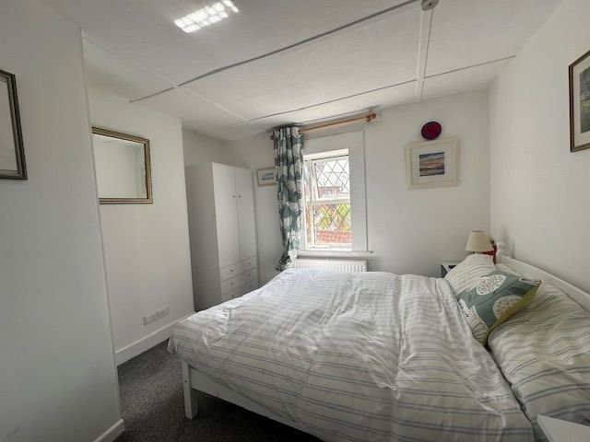
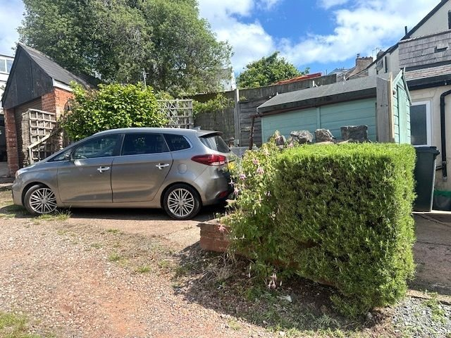
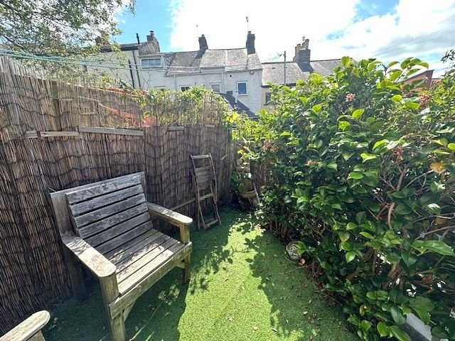
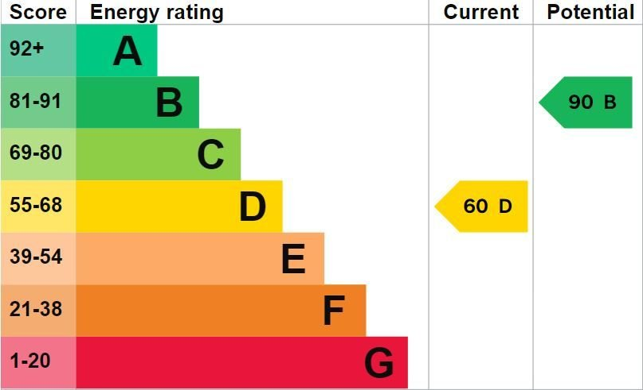
www.pennys.net
95 Fore Street, Exmouth, EX8 1HY
OFFERS IN THE REGION OF: £219,950
TENURE Freehold
A Charming Period Two Bedroom End Of Terrace Cottage Located Close To The Heart Of Exmouth Town Centre Offered For Sale With No Onward Chain
Entrance Porch • Dual Aspect Lounge With Gas Coal Living Flame Effect Fire •
Dining Room • Kitchen • Ground Floor Bathroom/WC •
Two First Floor Bedrooms - Main Bedroom With En-Suite Cloakroom/WC • uPVC Double Glazing & Gas Central Heating • Hard Standing Parking Area For One Car To Rear Of Property • No Onward Chain • Superb First Time Purchase/ Investment/ Holiday Retreat •
Pennys Estate Agents Limited for themselves and for the vendor of this property whose agents they are give notice that:- (1) These particulars do not constitute any part of an offer or a contract. (2) All statements contained in these particulars are made without responsibility on the part of Pennys Estate Agents Limited. (3) None of the statements contained in these particulars are to be relied upon as a statement or representation of fact. (4) Any intending purchaser must satisfy himself/herself by inspection or otherwise as to the correctness of each of the statements contained in these particulars. (5) The vendor does not make or give and neither do Pennys Estate Agents Limited nor any person in their employment has any authority to make or give any representation or warranty whatever in relation to this property.
PENNYS ESTATE AGENTS
2 Rolle House, Rolle Street, Exmouth, Devon, EX8 2SN
Tel: 01395 264111 EMail: help@pennys.net

Slide 2
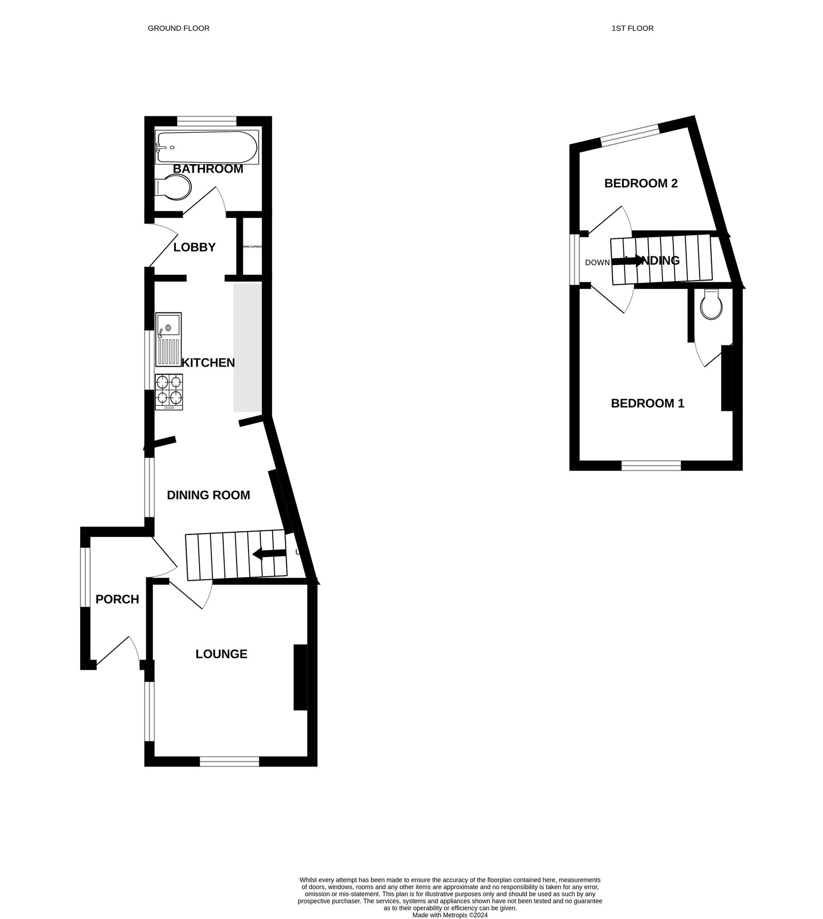
95 Fore Street, Exmouth, EX8 1HY
THE ACCOMMODATION COMPRISES: uPVC double glazed front door with patterned inset leading to: ENTRANCE PORCH: 2.11m x 0.94m (6'11" x 3'1") Wood effect flooring; uPVC double glazed window to side aspect; single glazed wooden inner door with obscure glass leading to: DINING ROOM: 3.3m x 3.05m (10'10" x 10'0") Narrowing to 7'6" (2.29m) by Kitchen. uPVC double glazed window to side aspect; wood flooring; radiator; ceiling lights; stairs to first floor landing with feature iron balustrade; smoke alarm; door to: LOUNGE: 3.28m x 3.02m (10'9" x 9'11") A bright dual aspect room with two uPVC double glazed windows to front and side aspects; attractive wall lighting; exposed feature ceiling beams; television point; gas coal living flame effect fire. KITCHEN: 2.72m x 2.11m (8'11" x 6'11") Fitted with patterned worktop surfaces with attractive tiled surrounds and a range of cupboards and drawer units; freestanding slimline dishwasher; plumbing and space for an automatic washing machine; stainless steel single drainer sink unit with mixer tap; two ring ceramic hob with built-in electric cooker beneath and drawer; space for freestanding fridge freezer; range of wall mounted cupboards; wall mounted electric fuse board; extractor fan; wood flooring; uPVC double glazed window to side aspect.
REAR LOBBY: Built-in airing cupboard housing Worcester gas boiler serving domestic hot water and gas central heating with slatted shelving below; uPVC double glazed door to outside; door to: BATHROOM/WC: 1.83m x 1.57m (6'0" x 5'2") Comprising of bath with wall mounted Triton shower, shower curtain and rail; WC with push button flush; pedestal wash hand basin; radiator; wall mounted cupboard; extractor fan; tile effect flooring; fully tiled walls; wall mounted clothes drying line; fitted mirror; uPVC double glazed window to rear aspect with obscure glass. FIRST FLOOR LANDING: Access to roof space; uPVC double glazed window to side aspect; smoke alarm; doors to: BEDROOM ONE: 3.23m x 3.02m (10'7" x 9'11") A spacious main bedroom with uPVC double glazed window to front aspect; radiator; television point; door to: EN-SUITE CLOAKROOM/WC: Fitted with WC; space saver wash hand basin with mixer tap; fitted shelf with mirror over; ceiling LED spotlight; extractor fan; tile effect flooring; attractive tiled walls. BEDROOM TWO: 2.77m x 2.21m (9'1" x 7'3") Maximum overall measurement. uPVC double glazed window to rear aspect; radiator.
OUTSIDE: To the front of the property there are a few steps giving access to a hard standing area and access to the front door. To the side of the property there is a concrete area ideal for storage purposes and access to gas and electric meters. To the rear of the property there is access via a pedestrian gate to a timber shed. There is also a hard standing area created to make a parking space for one car with shrub beds. Steps up to a raised patio with artificial grass ideal for outside seating enjoying a degree of privacy with mature shrubs.
FLOOR PLAN:

